Slide 1
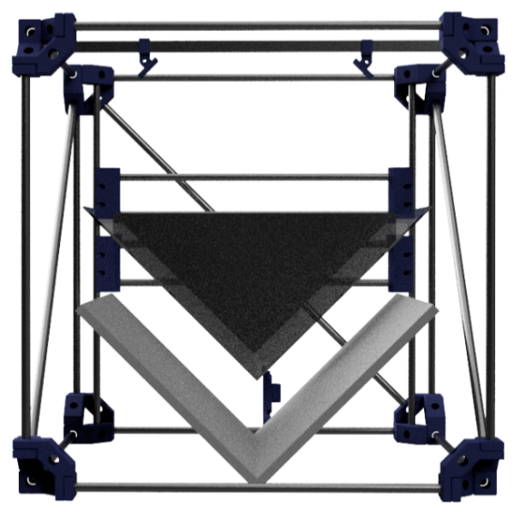
Scanbook project
Wesley Estievenart – Thomas Herpoel – Michael Manzella
Notes:
Hello everyone, and first of all thank you for being still here for the last presentation of the day! Wesley, Michael and I will present to you the product of our work, the scanbook version 2017

Slide 2
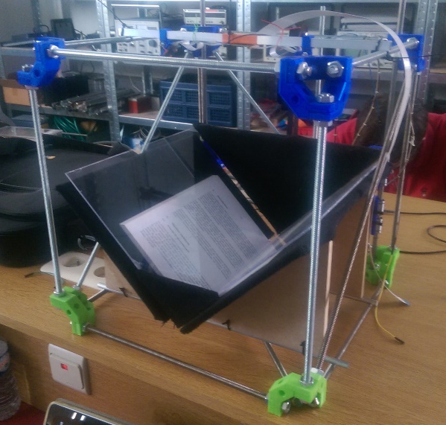
Introduction
Scanbook = Semi-automatic book scanner
2016
2017
Notes:
Some of you may not know what is the Scanbook project. It’s a semi-automatic book scanner and it’s purpose is to facilitate the process of digitizing a book by automatizing as much part of the process as possible. Basically, it uses a motorized mobile part to press glasses against the pages and cameras to take pictures of the pages.
Allow me to start with the results for once. On the left part of the slide you can see last year’s system and the right picture is the new one. Obviously you can spot a lot of changes between the two ! Basically every part of the design has changed: the mechanical system, the electronic and the software.

Slide 3
Introduction
Old system’s flaws
Controlled by Computer
Lack of stability
Motor driver issue
Bad quality camera
Limited software development environment
Bad lighting conditions
New system’s improvements
Controlled by embedded electronic
New camera (x2!)
New structure
Regular OpenCV
Still bad lighting… but easy to fix!
Notes:
We come from the old system which had a lot of flaws: some of them are listed here and some of the improvements that were made during this semester.

Slide 4
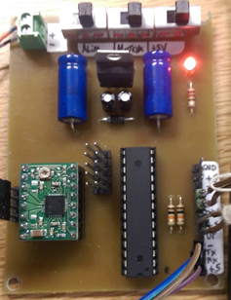
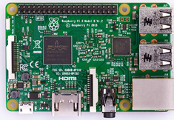

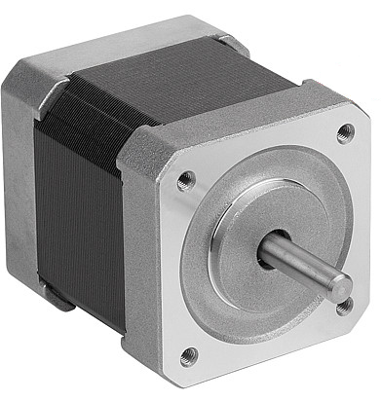
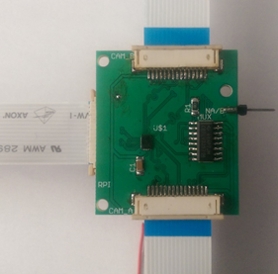
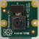
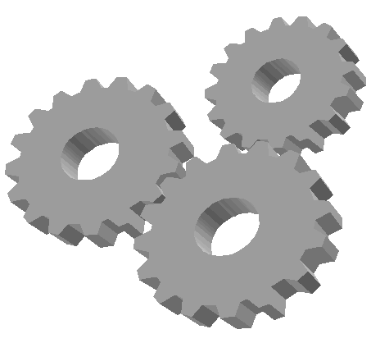

Introduction System design overview
Notes:
This is the global schematic of the Scanbook. The main component is the Raspberry Pi 3 which replaces the computer to control the whole system. The Raspberry Pi interacts with the two cameras and the motor control PCB. Cameras are connected to the Raspberry Pi through a switch circuit (because there is only one camera port on the Raspberry Pi). The PCB controls the motor and this one controls the mechanical part. The mechanical part is composed by mobile glasses and the two sensors mechanism to detect when the glasses are at the UP or DOWN position.

Slide 5
Content
Development
Results
Encountered issues
Conclusion

Slide 6
Development
Mechanics
Electronics
Software
Image processing
Control

Slide 7
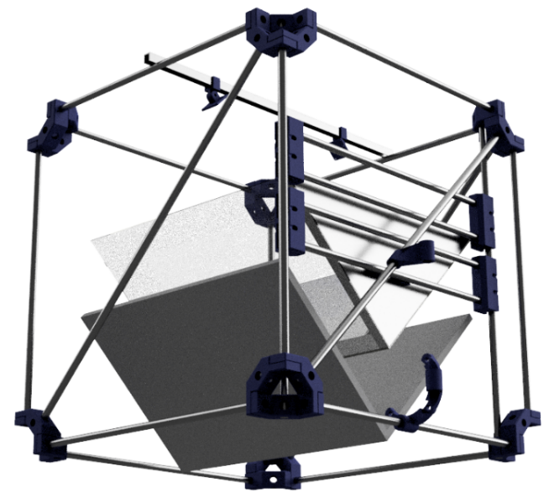
Development : Mechanics
CAD
+
3D printing
Notes:
A more stable structure was needed for the prototype. Since the CERISIC recently acquired a 3D printer and allowed us to use it, we figured it would be interesting to use CAD (computer assisted design) and 3D printing to make the structure.

Slide 8
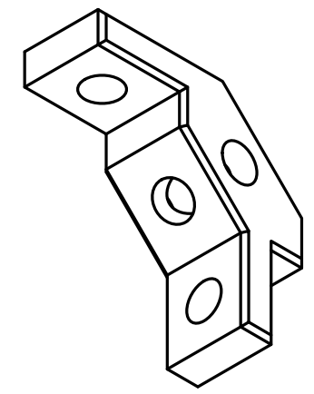
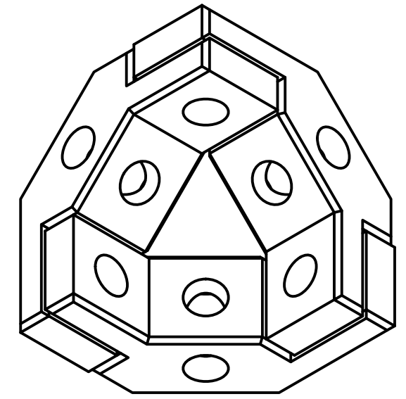
Development : Mechanics Modular design
Easy to 3D print base part
Complex module
3D printed small module
Interconnects “off the shelf” parts
Regular M8 threaded rods
Make big 3D structure possible!
Notes:
The big problems when designing a big structure for 3D printing is the limited size of the printer and the constraints on the geometry of the parts. The idea tested in this project was to design a simple small part that can be assembled into a corner assembly. Those corner assembly could then be connected by regular M8 threaded rods that you can find in any hardware store for cheap. Using this technique, it’s possible to make a structure with virtually no size limit.

Slide 9
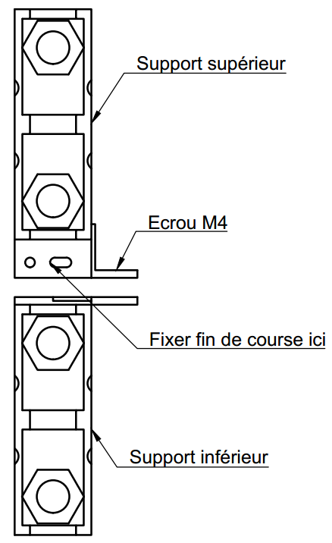
Development : Mechanics Down position detection
Two-part system
One fixed to the motorization’s belt
One fixed to the glasses
One micro switch in between
When the glasses hit an obstacle (book)
The micro switch triggers
Notes:
An idea from last year prototype was reused to detect the down position of the mobile part. This was done a two part system on the mobile part: one is fixed to the glasses and the other is fixed to the motorized belt. You’ll be able to see it properly on the prototype, but basically when the glasses hit an obstacle, a simple micro switch triggers and the system knows it is in its down position.

Slide 10
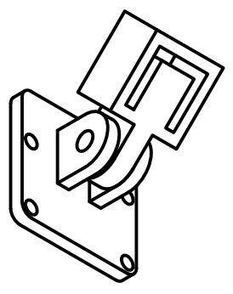
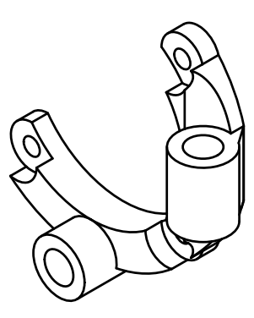
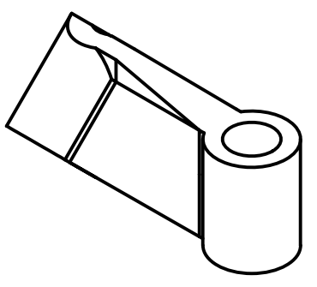
Development : Mechanics Many other parts…
Notes:
Many other parts where designed to hold the motor, to stabilize it or to hold the cameras.

Slide 11
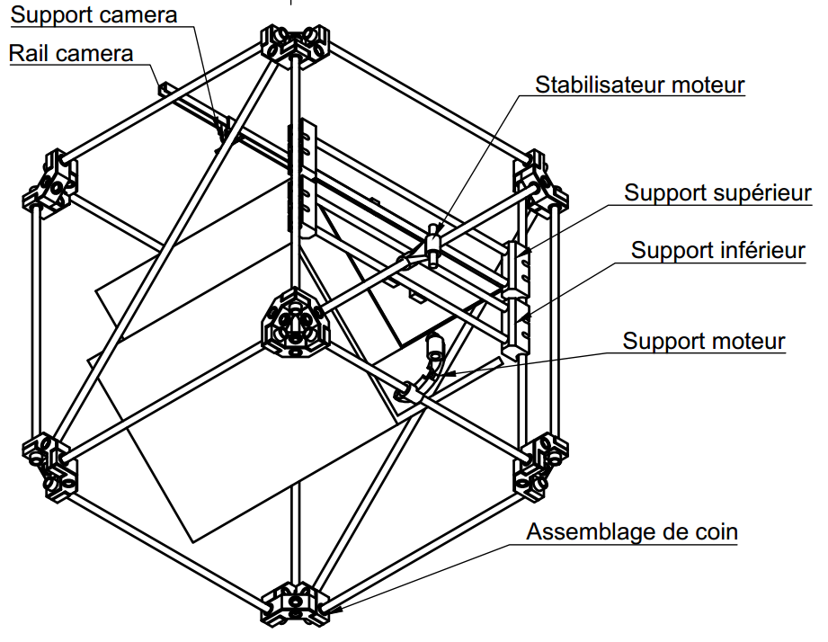
Development : Mechanics
Notes:
Here is an overview of the whole system, where you can see the corner modules connected together by simple rods, and the other parts attached to those rods.

Slide 12
Development
Mechanics
Electronics
Software
Image processing
Control
Notes:
As we are Electronics engineering students, let’s see a little bit of actual electronics.

Slide 13
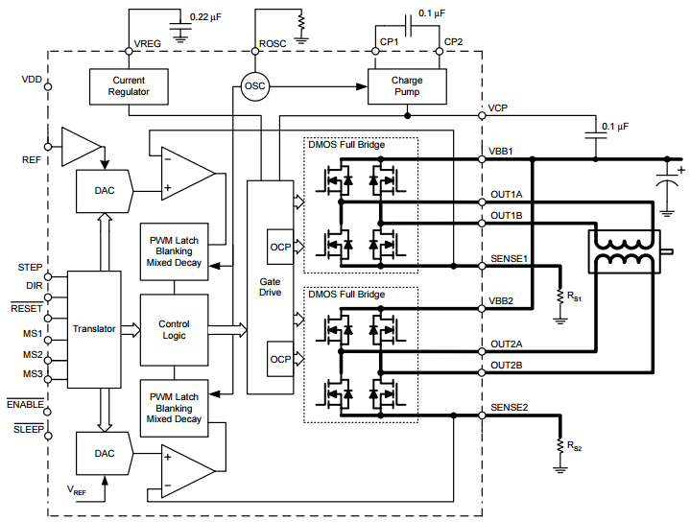
Development : Electronics Motor driver issue
When motor disabled :
Mobile part moves freely (thanks to gravity)
Back EMF generated in motor coils
Flyback diodes in the driver IC break down
Solution :
Force /ENABLE to GND
Motor is always enabled
AD4988 Driver IC
Notes:
Last year, there was a problem with the motor and the driver. When the motor was disabled at the UP position, it falling down (thanks to gravity) and ElectroMotive Force were generated and returned to the driver. The diodes in the driver break down.
To solve this problem, we forced the “enable” pin of the driver to the ground. So, the motor is always supplied.

Slide 14
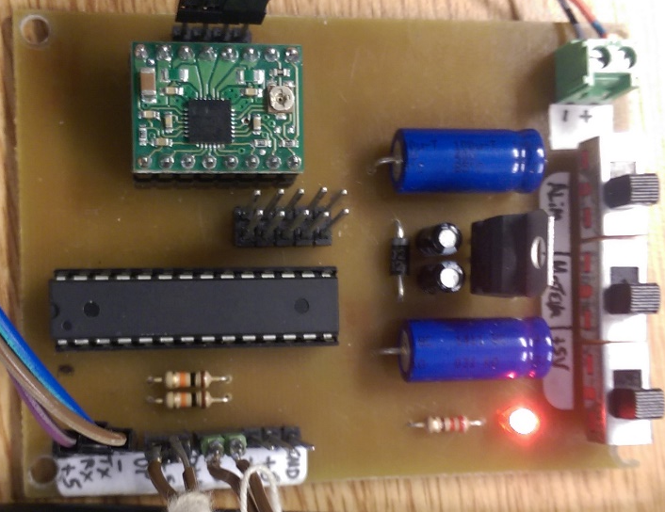
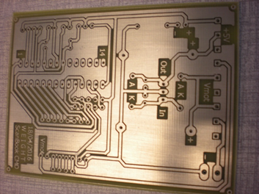
Development : Electronic
Two part
Power supply
Motor control
Modified to solve driver problem
The motor driver is always powered and enabled
Reused PCB from Scanbook 2015-2016
Modified to match the new circuit
Notes:
The PCB used to control the motor is represented on the two pictures. It is composed by two main part : the power supply and the motor control part.
The power supply part has three switches to control all the voltages. And there is also a rectifier to convert the supply voltage (about 10-12 V) to a 5V voltage. The 5V voltage is used to supply the microcontroller and the driver. And the supply voltage is used to supply the stepper motor. The rectifier allows to have a single external power supply.
The motor control part has a microcontroller, a stepper motor driver and several connectors. The microcontroller exchange messages with the Raspberry PI and controls the driver. This one control the stepper motor. Connectors are used to connect the Raspberry PI, the two sensors, the motor and the ISP (to program the microcontroller).
Last year’s PCB has been modified and reused because it works fine except from the motor driver problem.

Slide 15
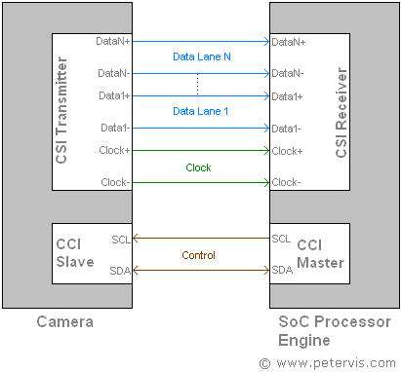
Development : Electronic Camera multiplexer
MIPI CSI-4 lanes camera interface
Image data transfer
Between Pi Camera and Raspberry Pi
High speed differential serial communication (up to 1 Gbps per lane)
Licensed protocol (expensive specifications under NDA)
Good news : a special purpose IC is available !
Bad news: it only exists in a really tiny QFN package …
Pi Camera
Raspberry
Notes:
As we said earlier, we wanted to use two cameras. Unfortunately, the raspberry Pi only has one camera interface! We had some options there: using two raspberry Pi 3, using one raspberry pi 3 and one raspberry Pi Zero which is a lighter and cheaper version or putting the camera on a motorized XY system. But the solution used this year is to design and sue a switching electronics circuit to connect the two cameras to one raspberry.
The interface used to transfer the image data is a MIPI CSI 4 lanes. It is an high speed serial communication (up to 1Gbps) and it’s licensed so it’s really hard to find specifications about this interface.

Slide 16
Development : Electronic Camera multiplexer
CCI control interface
Detection and configuration of the camera
Between Pi Camera and Raspberry Pi
Regular I²C communication
Good news : well known interface, easy to multiplex with regular logic IC
Bad news : actual configuration of the camera is hidden in a binary blob in the Raspberry Pi firmware (it is NOT open source)
Pi Camera
Raspberry
Notes:
Another interface is used between the camera and the raspberry Pi: the CCI control interface is used by the raspberry to detect and configure the camera. It is a simple I²C communication, so it’s well known and we can use regular logic IC’s to do the switching, but the actual configurations is hidden in a binary blob in the Raspberry Pi firmware.

Slide 17
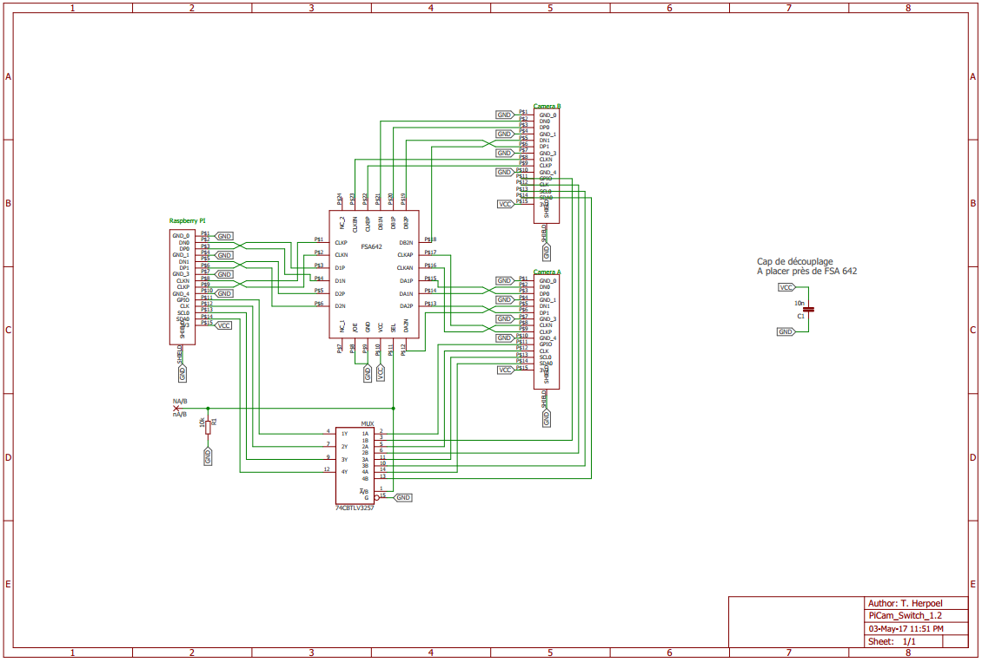
Development : Electronic Camera multiplexer
Fairchild’s FSA642 IC for MIPI CSI-4 lanes multiplexing
74CBTLV3257 MUX/DEMUX IC for I²C switching
Camera A is selected by default

Slide 18
Development
Mechanics
Electronics
Software
Image processing
Control

Slide 19

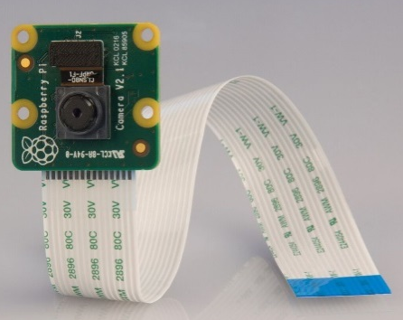
Development : Software Image processing
Notes:
Concerning the image processing, we chose to use the OpenCV library on the Raspberry pi. It is a library specialized in real time image processing. After installing the library, we started to do several tests with the Pi Cameras used. Each of the cameras allow to take a single-page shot. These two cameras are connected to the electronic switch circuit seen previously.
The tests were carried out in two parts : the first step is to detect the outline of a page of the book and the second step is to correct and stretch the picture of a single page.
The following slides will present a simplified version of the image process steps.

Slide 20
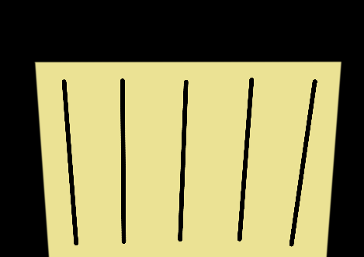
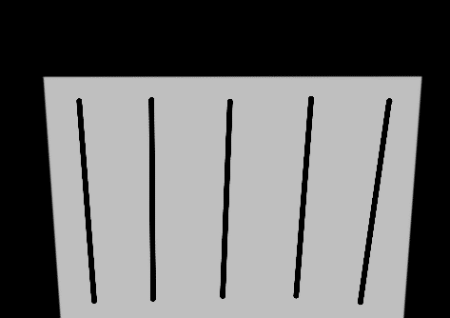
Development : Software Image processing
Original
Gray
Notes:
At first, the color picture is converted to grayscales.

Slide 21


Development : Software Image processing
Gaussian filter
Canny filter
Notes:
Secondly, a Gaussian filter is applied to reduce the noise and the details of the picture. This step has the effect of blurring the picture.
Third, we apply a Canny filter which allows to detect the contours of all the elements in the picture.

Slide 22

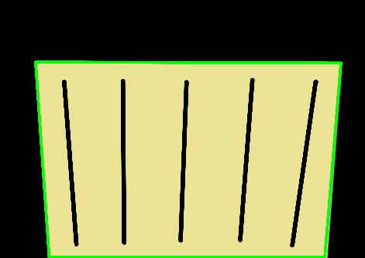
Development : Software Image processing
Rotation and stretching
Contour detector
Notes:
Fourth, we apply a contour detection algorithm and display the retrieved contour on the colour picture.
And finally, we stretch the picture.

Slide 23
Development
Mechanics
Electronics
Software
Image processing
Control

Slide 24
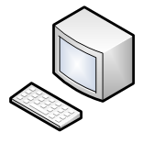
Development : Software Control
Computer controlled => Raspberry PI 3 controlled
What is a Raspberry PI ?
O.S. installation, configuration
Programming & Image processing
Notes:
As we said before, the system is now controlled by a Rasperry PI and not a computer. But what is a Raspberry PI ? It is a nano-computer that has the size of a credit card. Many models exist and the one used in the Scanbook project is the Rasperry Pi 3. It cost about € 35 and it allows to make the Scanbook a compact and autonomous system.
The control program of the Scanbook was developed on the Raspberry but it actually first required an O.S. and a lot of configuration to work properly !
The configurations concerned the image processing library, the serial communication with the PCB, the touch screen, and so on. Installation and all the configurations took time, about 16h !!!
After the installations and configurations were finished, the software development and image processing parts had finally started.

Slide 25
Development : Software Control
Serial commands from Raspberry Pi to PCB :
UP, DOWN, DISABLE, FULL, HALF, QUARTER, EIGHTH, SIXTEENTH
Serial commands from PCB to Raspberry Pi:
ISUP, ISDOWN, ISSTOP, STEPSIZESET, ERROR
Ex . : UP command is received
The stepper motor turn and when the UP sensor detects the mobile part, motor is automatically disabled. Then, the PCB return ISUP command.
Notes:
This is the list of commands exchanged from the Raspberry Pi to the PCB.
UP and DOWN commands are used to move the mobile part composed by the glasses. The DISABLE command is used to stop any movement. The five remaining commands are used to set the step size of stepper motor.
There are also commands sent by the PCB to the Raspberry Pi.
ISUP and ISDOWN commands are the answer to UP and DOWN commands. ISSTOP is the answer to DISABLE command and STEPSIZESET is the answer for the fives other commands.
There is also a ERROR command in case we need it later.
There is an example of command received from the Raspberry Pi. The PCB receives it and performs the command. The sensor detects the mobile part when it is in the top position, the PCB stop the movement and sends a ISUP command to the Raspberry Pi.

Slide 26
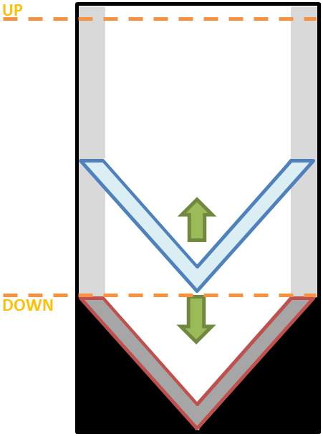
Development : Software Control
Currently, controlled by 4 buttons on Raspberry Pi’s GPIOs:
Start
Next
End
Stop
Serial messages between Raspberry PI & PCB
UP and DOWN sensors connected on the PCB
Motor control on the PCB
Notes:
The Scanbook is controlled by 4 buttons : Start, Next, End and Stop. The start button allows to start a new book, the next button is used to go to the next page, the end button is used to finish the book and the stop button allows to stop the scan and shut down the program. The Raspberry Pi sends and receives command and sensors information to control the mechanical part and the scan sequence.

Slide 27
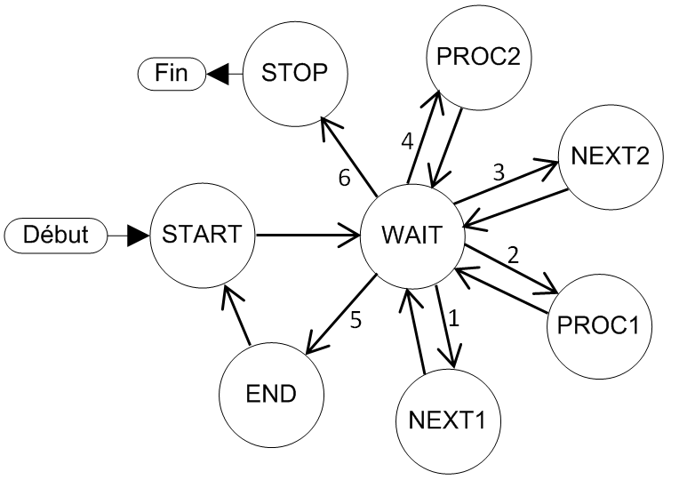
Development : Software Scanning sequence
Initialisation
Display « press start »
Start
Up command
Display « press next or end »
Next
Down command
Display « scan in progress »
Takes pictures
Image processing
Return to start button process
End
Display « scan completed »
Return to initialisation process
Stop
System shutdown
Notes:
On the left, there are the actions performed when buttons are pressed in a complete scanning process.
First, the Scanbook is initialized and display “press start”. When the “start” button is pressed, the UP command is sent to the PCB and a new message is displayed “press next or end”. If the “next” button is pressed, DOWN command is sent, message is displayed, pictures are taken and processed, UP command is sent and a new message is displayed. If the “end” button is pressed, a message is displayed, the books is finished and the program return to the initialisation part. When the “stop” button is pressed, the system shutdown.
The diagram on the right shows the state machine of the system that defines this sequence.

Slide 28
Content
Development
Results
Encountered issues
Conclusion

Slide 29
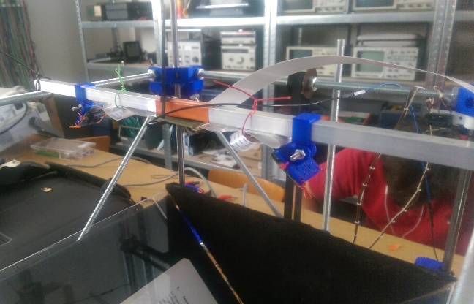
Results : Mechanics
Notes:
So there is not much to say about the mechanical results. Basically the structure is quite stable and it’s modular nature makes it easy to modify. There are still some parts to design in order to have a perfectly clean structure, and some thinking to put in the stability of the mobile part. Indeed it works really well, but the stability of it could be a little bit better.

Slide 30
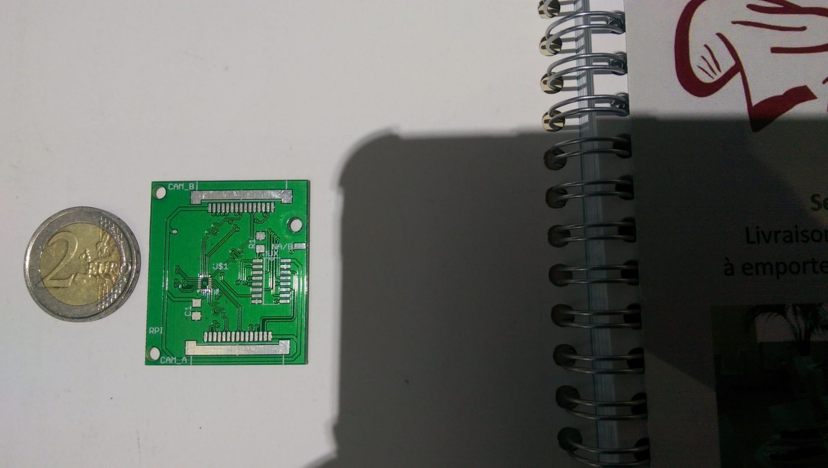
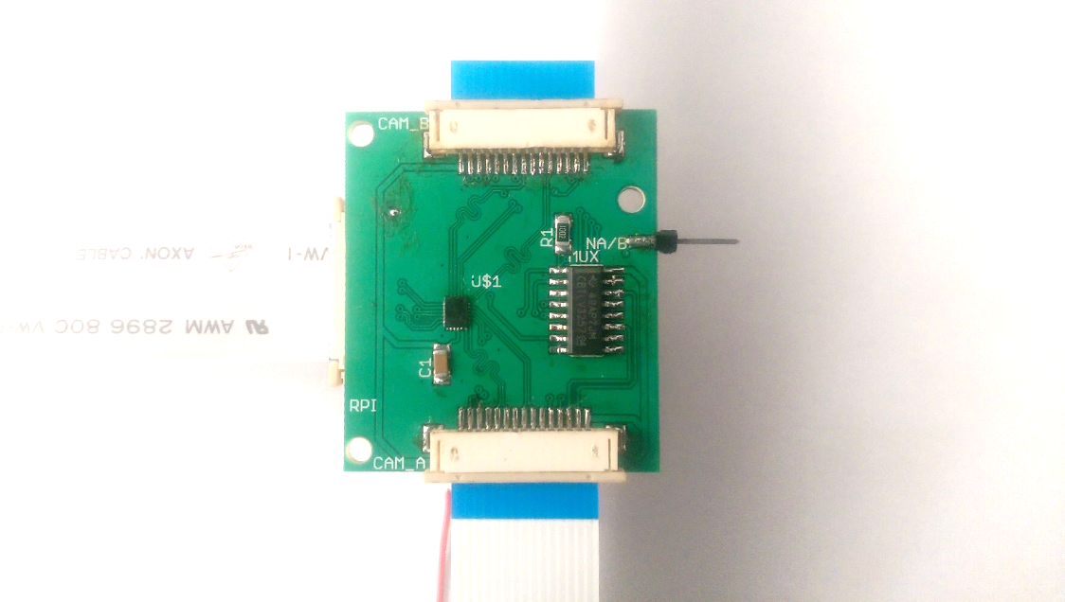
Results : Electronic Camera multiplexer
2-layer PCB
Populated
FSA642 in QFN package : 2.5 x 3.4 mm
Notes:
About the electronics circuit results: you can see the result of the PCB design on the left: a 2 layer PCB made with the website elecrow. Extra care was given to match the length of all the differential signals traces.
On the right you can see the populated PCB, and especially the really tiny QFN package! This PCB has been tested and proved to be fully functioning.

Slide 31
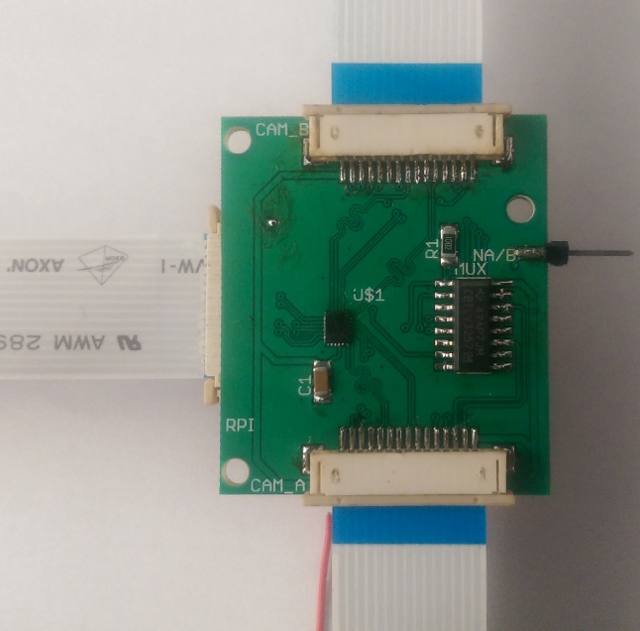
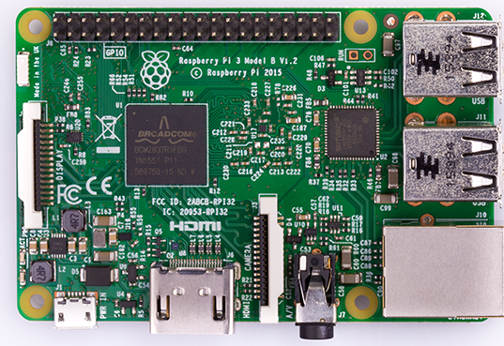
Results : Electronic Camera multiplexer
Python
script
Notes:
A basic and simple python script was done to test and prove the switching of the two cameras on the Raspberry pi, and the system is now able to take pictures from both cameras.

Slide 32
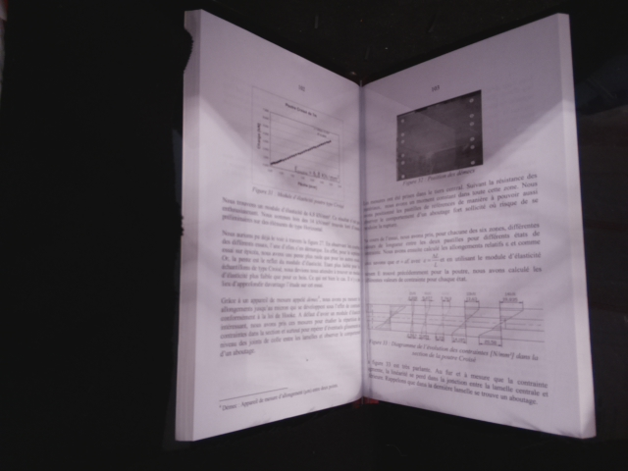
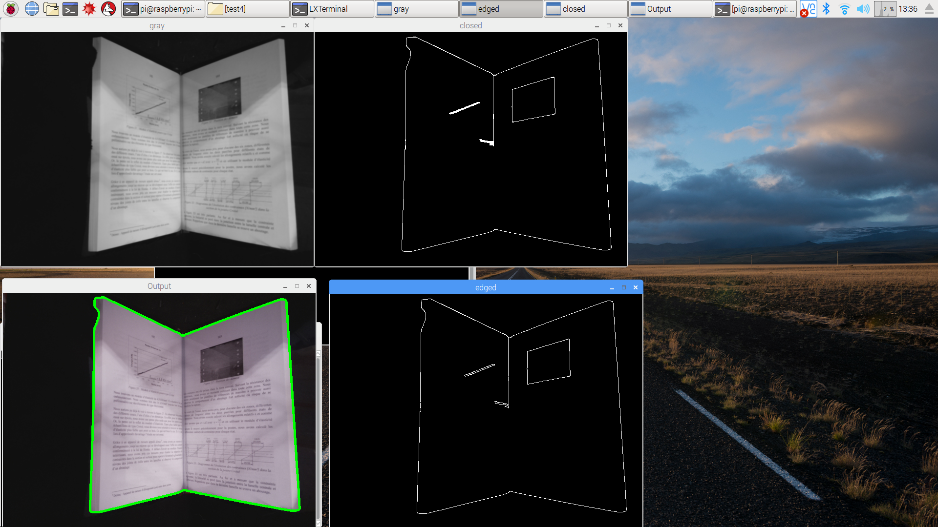
Results : Image processing
Original
Gray + Gaussian filter
Notes:
Here are the image processing results. The first tests performed were is to try to detect the outline of a whole book.
We have on the left the original picture and on the right the conversion into gray scale and with the Gaussian filter.

Slide 33
Results : Image processing
Gray + Gaussian filter
Canny filter
Notes:
Then we apply the Canny filter to detect the contour of the picture’s elements. We can see that with this algorithm we detect elements on the pages, like the figures.
A threshold value can be configured to tweak the detection.

Slide 34

Results : Image processing
Canny filter
Contour detector
Notes:
Finally, we apply the detection of contours and draw it. This test is successful, but let’s see what happens when the threshold value is changed.

Slide 35
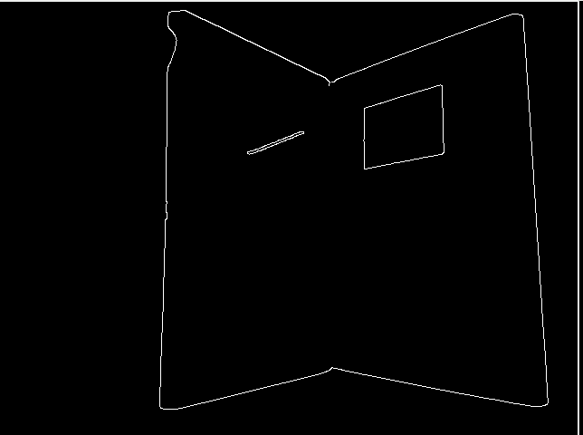
Results : Image processing
Threshold settings
Basic picture
Threshold Value
Notes:
If we increase the threshold value, we see that some part of the inside of the pages, like parts of the text and the central part of the book, have disappeared.
In this case increasing the threshold is improving the result but we can also have the opposite effect by decreasing it.

Slide 36
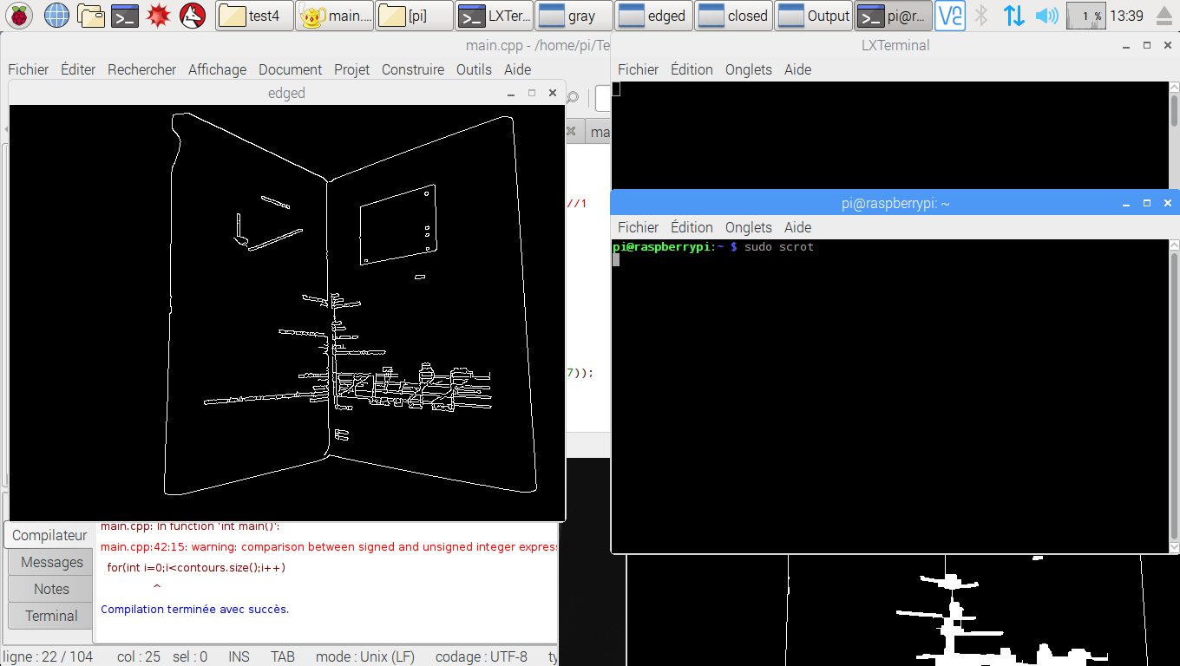
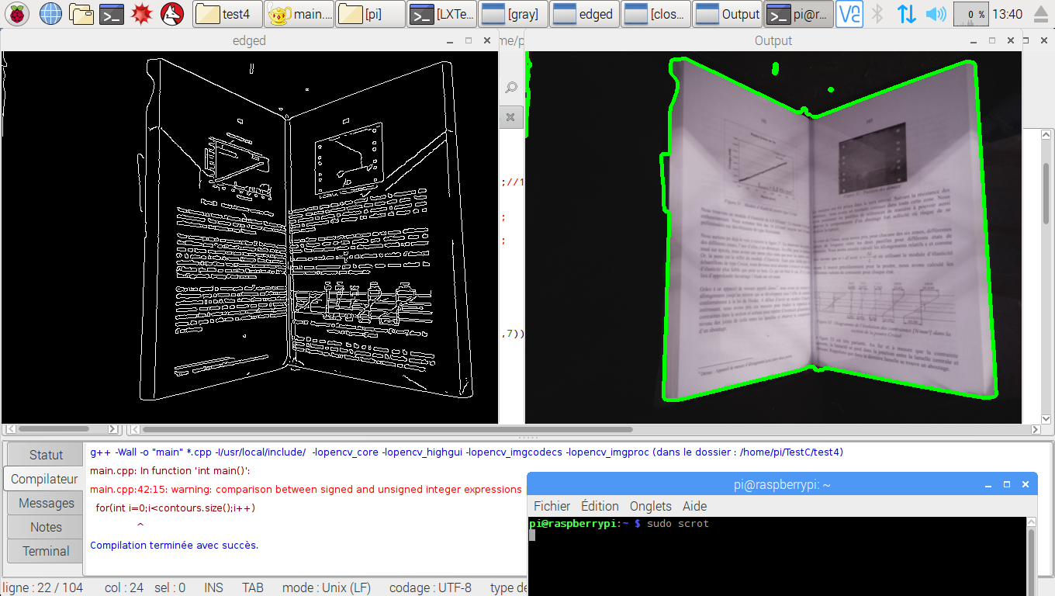
Results : Image processing
Threshold settings
Threshold Value
Threshold Value
36
Notes:
If we lower the threshold value of the Canny filter, more elements of the book are appearing, like the figures and almost the whole text. The problem is that the result on the final detection of the contour will be worse and imperfections appear.

Slide 37
Results : Image processing
Threshold settings
37
Notes:
Here is the result of the contour detection algorithm with a lower threshold value. We can see a decrease in quality of the detected outline and also the detection of parasitic elements outside the book.

Slide 38


Results : Image processing
Notes:
Here are the two results with different threshold values. This first test allowed to illustrate the importance of the threshold value to obtain a satisfying result!

Slide 39
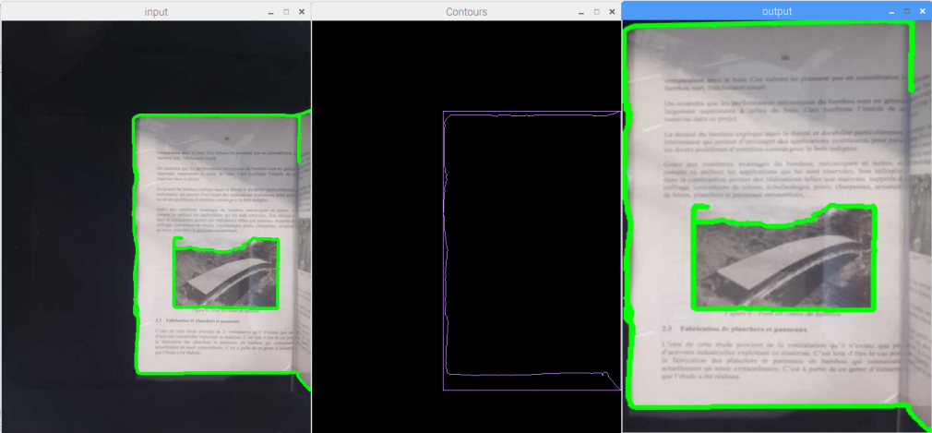
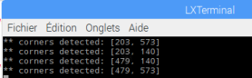
Results : Image processing
Notes:
The second test was performed to try the stretching and correction of the page. This test was done on a single-page picture.
After performing the steps mentioned previously to detect the contour, an algorithm detects the largest rectangle on the picture and return the coordinates of the four corners. We can see below the values of the four corners returned by the algorithm. The only remaining step is to stretch the image in the perfect shape.

Slide 40
Results : Image processing
Notes:
But we do not get a satisfying result. The problem is that a part of the second page is detected in the detection of our contour. The solution to this problem would be to hide this part in a software way by adding a black strip.

Slide 41
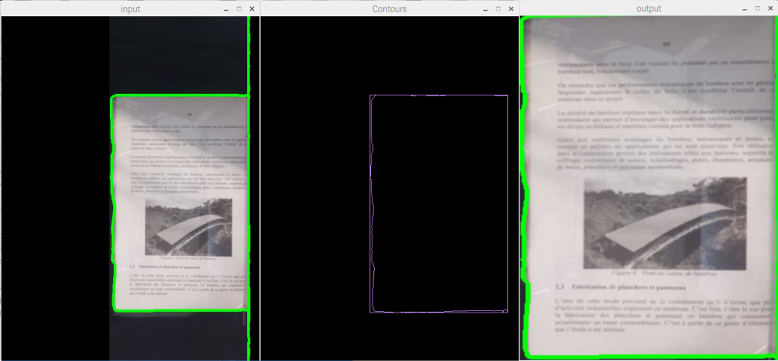
Results : Image processing
Notes:
In this example, we added a black strip to hide the second page. The result obtained is more satisfying than the previous one. But this solution can only be used if the cameras do not change position and depends on the size of the book

Slide 42
Content
Development
Results
Encountered issues
Conclusion

Slide 43
Encountered issues
Soldering a QFN component
Really small component, requires hot air or oven soldering
Install the OpenCV library on Raspberry Pi
Serial communication configuration with a Raspberry Pi 3
Serial interface is normally used with internal bluetooth component
Graphical interface configuration
43
Notes:
Some of the issues we had during the project are listed here.
The QFN package soldering was basically a nightmare. It requires hot air or oven reflow soldering and we are not trained to do it efficiently.
The OpenCV installation and configuration on the raspberry Pi took a lot of time, that caused a delay in the starting of the software implementation.
The serial interface configuration on the Raspberry Pi 3 was also difficult because in the version 3 it is used by the Bluetooth internal component of the raspberry pi 3. A lot of configuration had to be done to disconnect it from the Bluetooth component to be able to use it ourselves.
Finally the graphical interface configuration took too much time for us to be able to produce a usable GUI before the end of the semester

Slide 44
Content
Development
Results
Encountered issues
Conclusion

Slide 45
Conclusion Current state of the project
Improved prototype
3D printing allowed for a better mechanical system
Electronics
Switch to connect two cameras
Motor driver issue is solved
Image processing
OpenCV in an embedded system
All subsystems are working !
mechanics, electronics, cameras, software, sequence of scan, …
Notes:
To conclude, let’s see the current state of the project. We have an improved mechanical structure, we have solved the motor driver issue form last year, we have a 2 cameras setup which basically allows us to have enough resolution for a usable final result, and the image processing is now done on an embedded system with the full version of the OpenCV library.
In a word, we can argue that every part of the system we developed are now functionnals!

Slide 46
Conclusion Next year
Mechanical improvements :
3D parts conceptions
Close the structure
Electronical improvements :
Lighting system
Add touch screen & graphical user interface
Software improvement :
Implement PDF file generation
Send the PDF file by mail
Improve the image processing
Use OCR ?
Integrate all the subsystems together !
Notes:
A list of various improvements is given on the slide. But the most important thing to consider is the actual integration of all the subsystems we developed into a complete functional system. Once this thing is done, we think the prototype will be able to do its first complete scan of a book, and from there the work can be focused on the practical details, like improving the quality of the image processing or automatically generating and sending a pdf file containing the book.

Slide 47
Conclusion Next year
https://github.com/ThomHPL/ScanBook_2017
For next year’s students:
Documentation
Installation guides for all parts of the system
Wiring guides
Schematics and PCBs
Software
Control software on the Atmega
Control software on the Raspberry
OpenCV software
Python script to switch cameras
Available on the DVD and on the git repository!
47
Notes:
To finish this talk, let’s talk about the various documents available for next year’s students. Documentation has been done to try to make them familiarize easily with it. All the source codes and working files along with this documentation will be found on the git repository.

Slide 48
Thank you for your attention !

Slide 49

Questions

